Slide 1
Fonts
The font used is Encode Sans
This font can be downloaded from uw.edu/brand
The supplemental font used is Open Sans

Slide 2

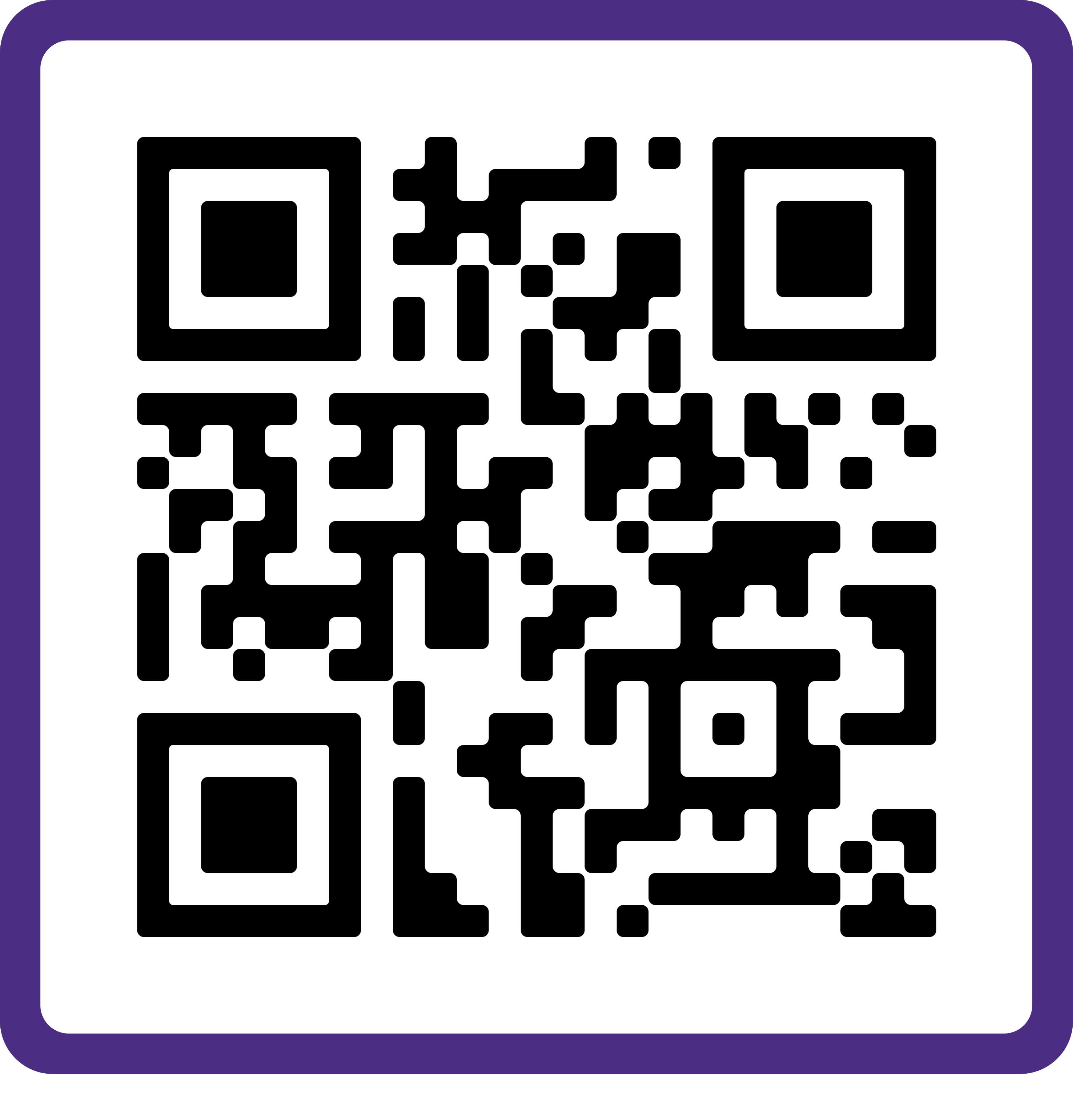

Dean’s Office
OFFICE HOURS
MONDAY | 8:00 – 3:00
TUESDAY | 8:00 – 3:00
WEDNESDAY | 8:00 – 3:00
THURSDAY | 8:00 – 3:00
FRIDAY | 8:00 – 3:00
*Office closed daily from 12:00 – 1:00
We are online/accessible during normal business hours, 8:00 a.m. – 5:00 p.m.
Our core hours in Gould Hall are Monday – Friday, from 8:00 a.m. – 3:00 p.m.
Dean’s Office
Gould 224

Slide 3


Dean’s Office
OFFICE HOURS
DECEMBER 20TH TO JANUARY 4TH
CBE will be working remotely
Dean’s Office
Gould 224

Slide 4
Dean’s Office
OFFICE HOURS
DECEMBER 20TH TO JANUARY 4TH
CBE will be working remotely
Dean’s Office
Gould 224

Slide 5
Advancement
OFFICE HOURS
MONDAY | 10:00 – 3:00
TUESDAY | 10:00 – 3:00
WEDNESDAY | 10:00 – 3:00
THURSDAY | 10:00 – 3:00
FRIDAY | 10:00 – 3:00
We are online/accessible during normal business hours, 8:00 a.m. – 5:00 p.m.
Our core hours in Gould Hall are Monday – Friday, from 10:00 a.m. – 3:00 p.m.
Deliveries can be made to Gould 224.
Advancement
Gould 424

Slide 6
Advancement
HOURS OF OPERATION
PHYSICAL OFFICE
REMOTE OFFICE
MONDAY | 10:00 – 3:00
TUESDAY | 10:00 – 3:00
WEDNESDAY | 10:00 – 3:00
THURSDAY | 10:00 – 3:00
FRIDAY | 10:00 – 3:00
MONDAY | 10:00 – 3:00
TUESDAY | 10:00 – 3:00
WEDNESDAY | 10:00 – 3:00
THURSDAY | 10:00 – 3:00
FRIDAY | 10:00 – 3:00
We are online/accessible during normal business hours, 8:00 a.m. – 5:00 p.m.
Our core hours in Gould Hall are Monday – Friday, from 10:00 a.m. – 3:00 p.m.
Deliveries can be made to Gould 224.
Advancement
Gould 424

Slide 7
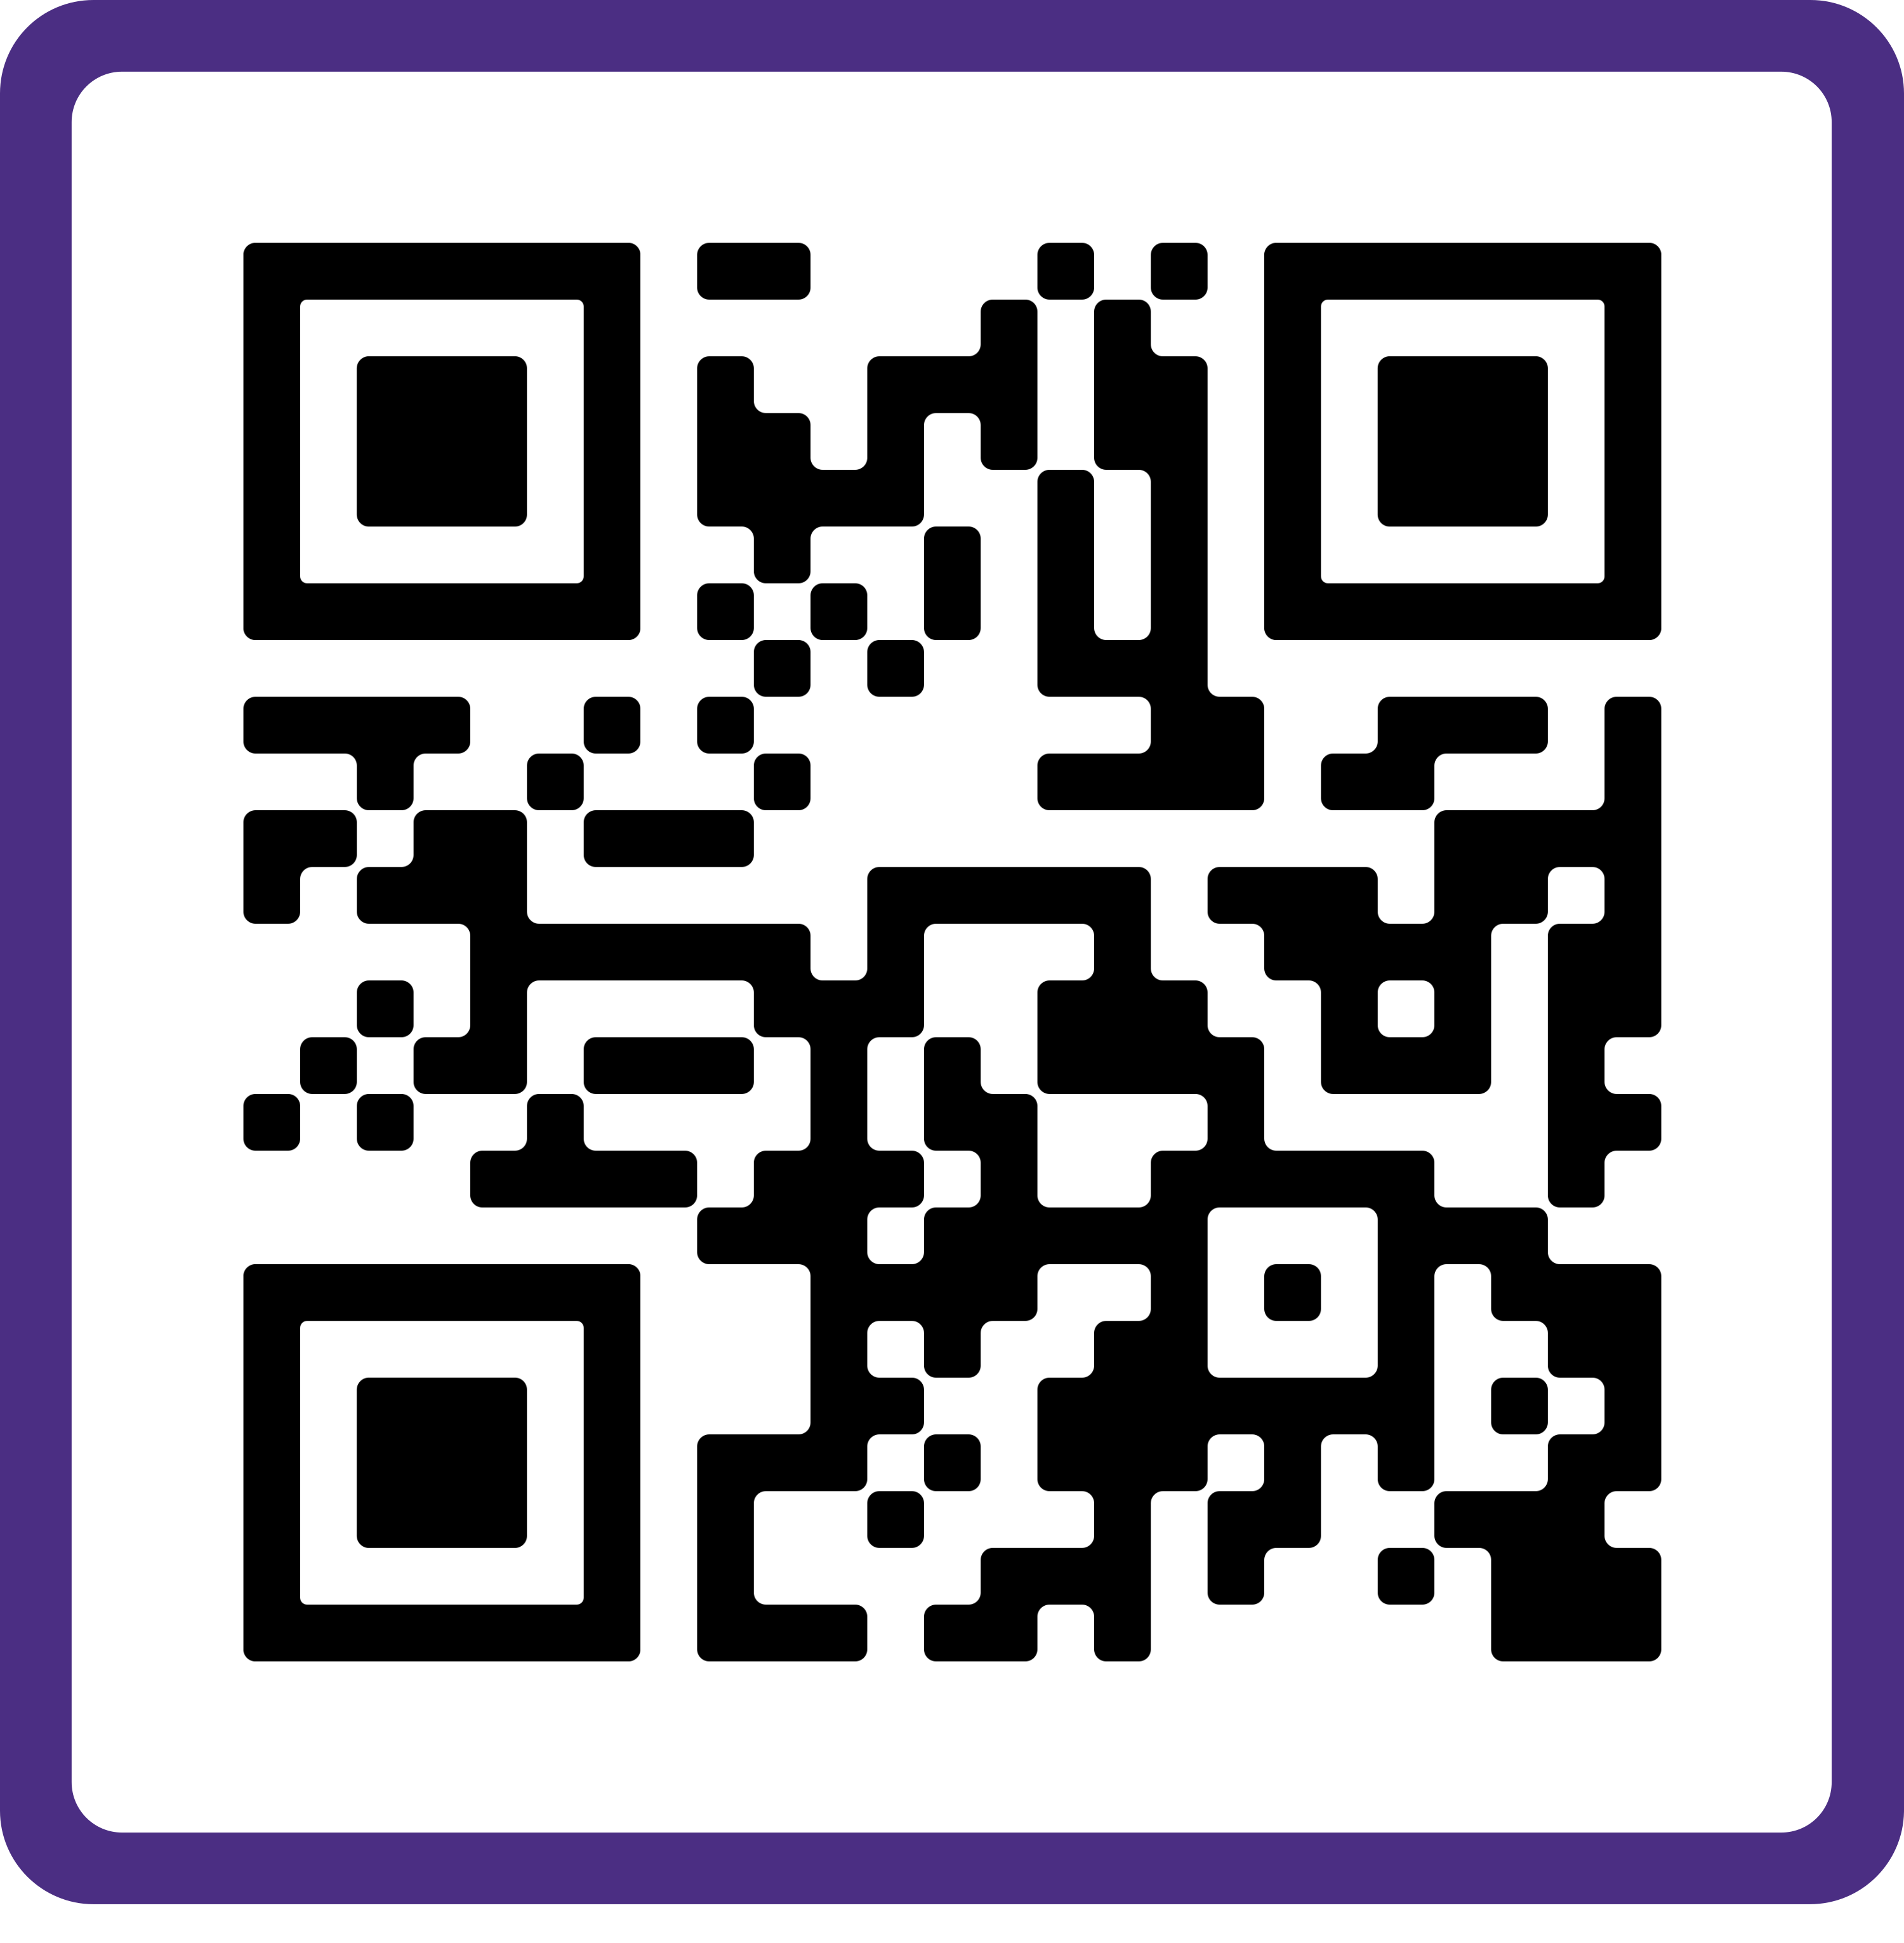
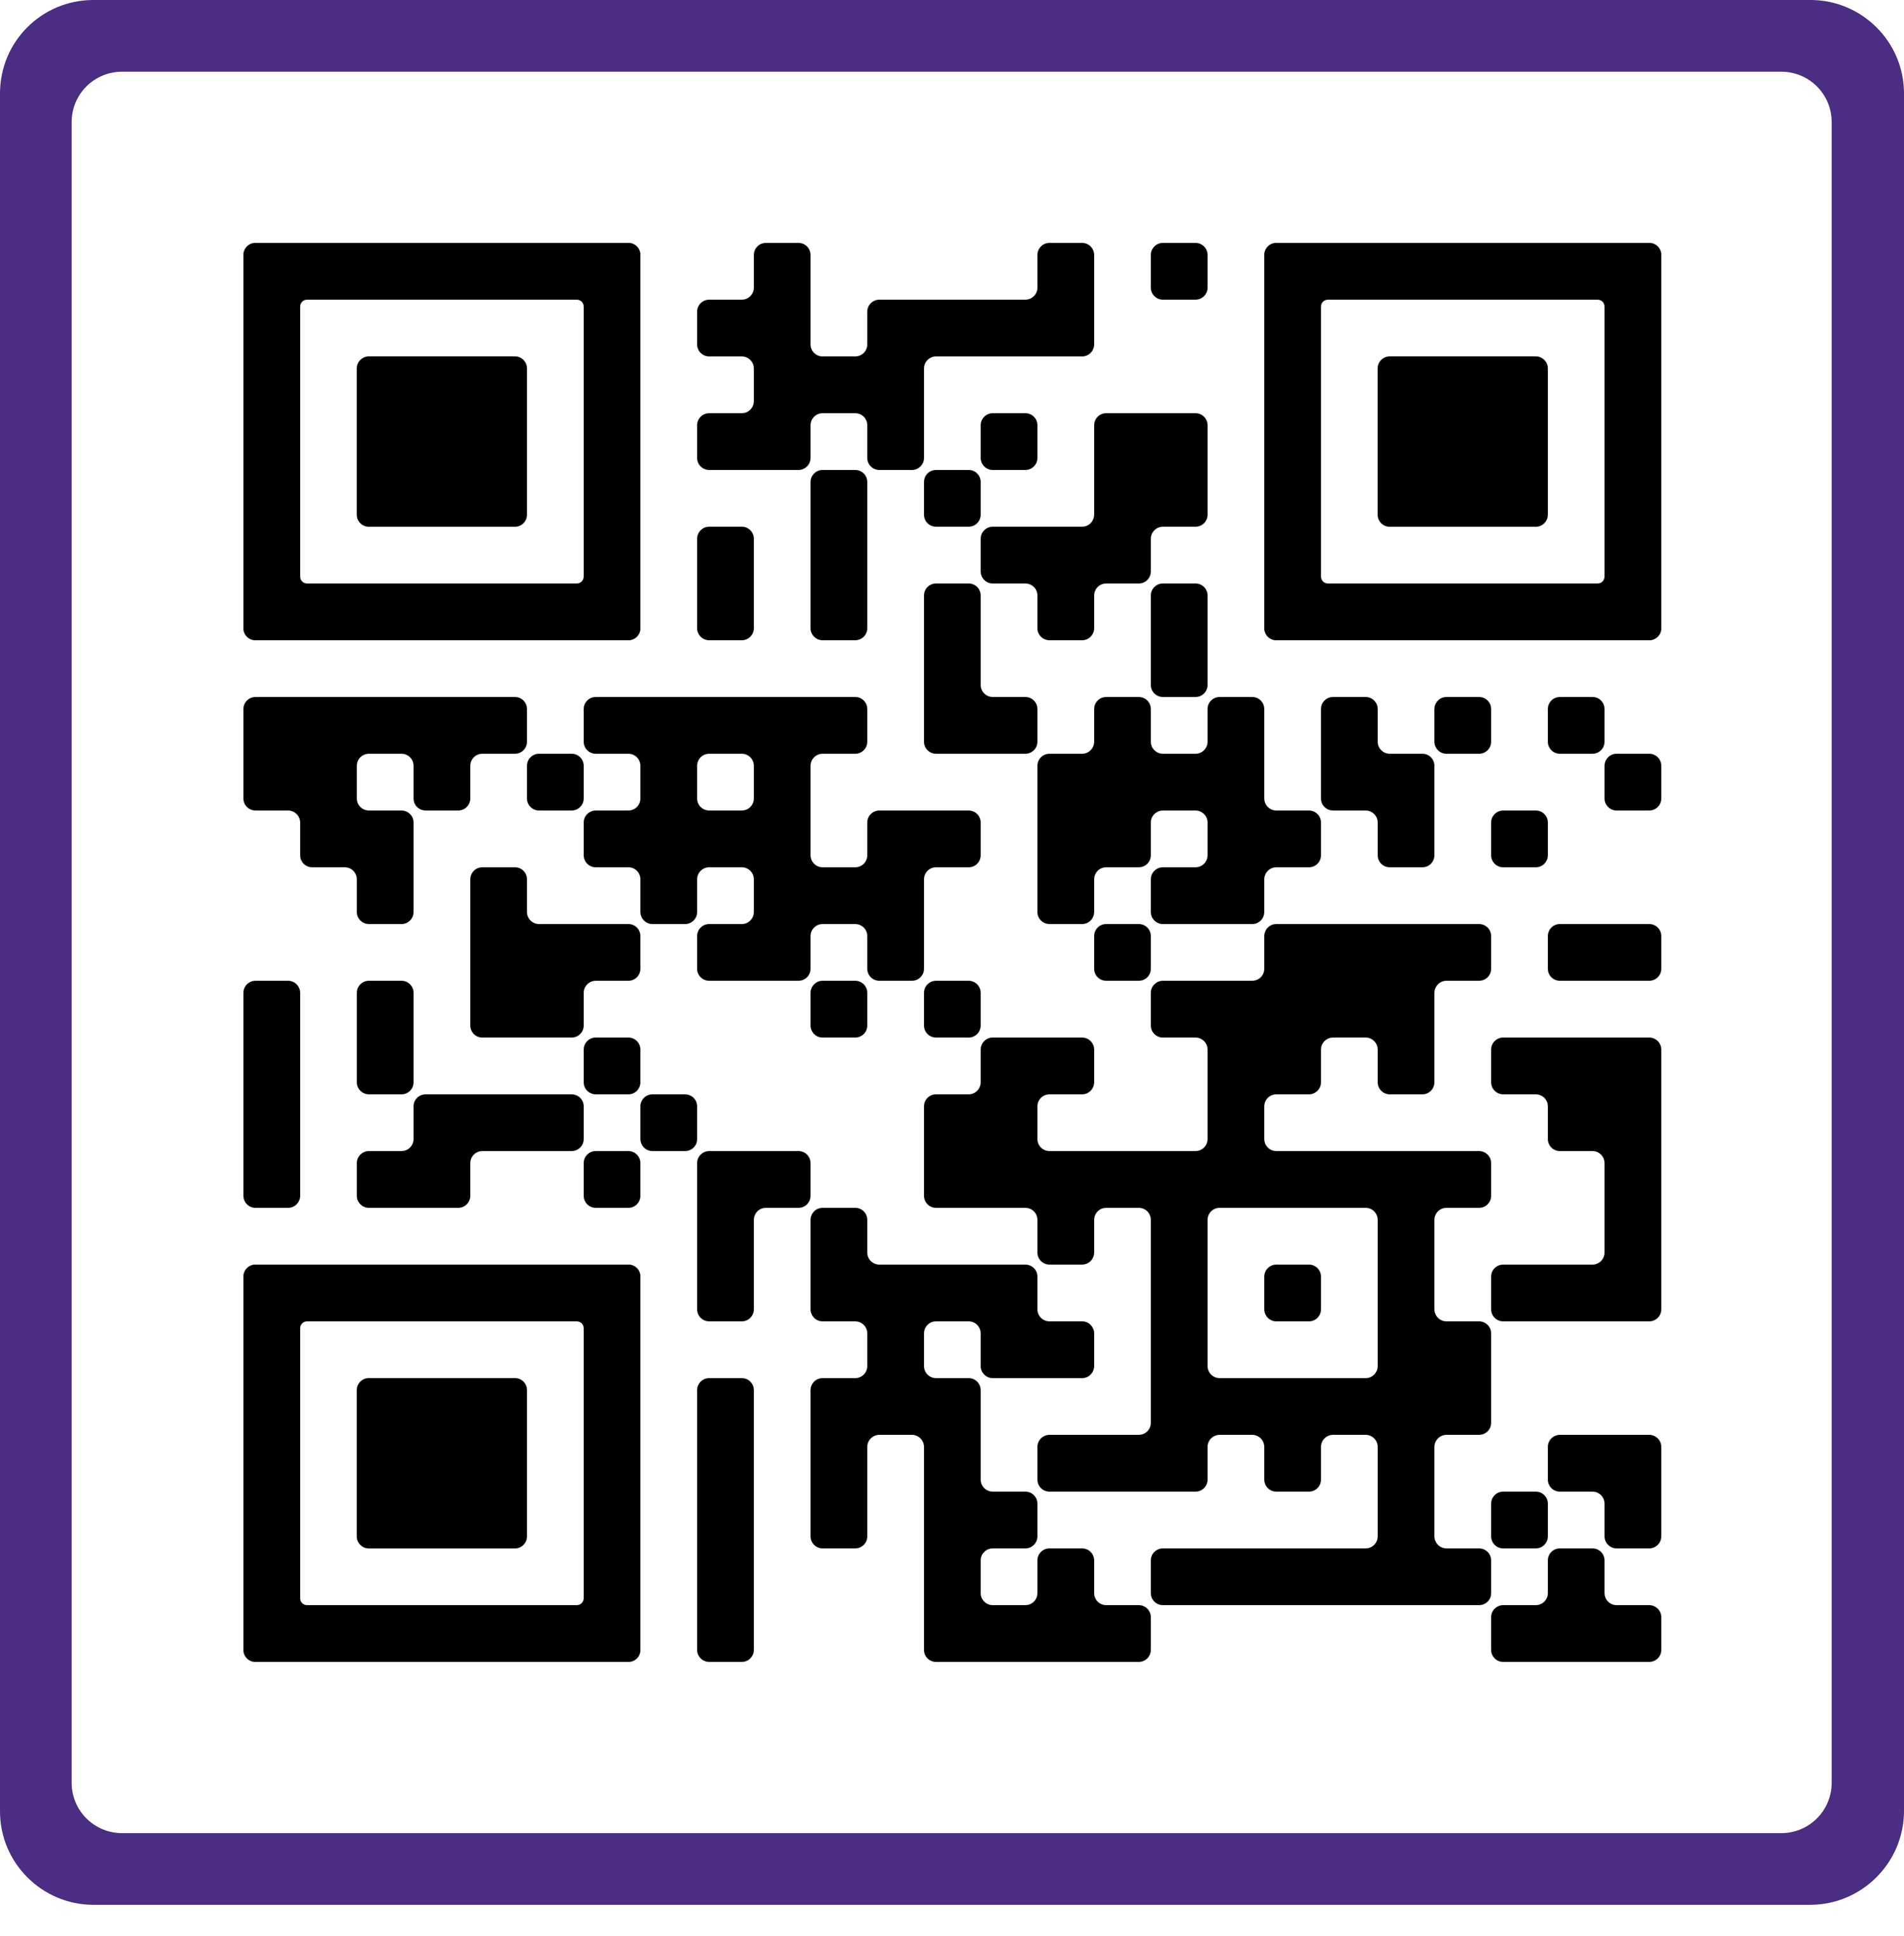
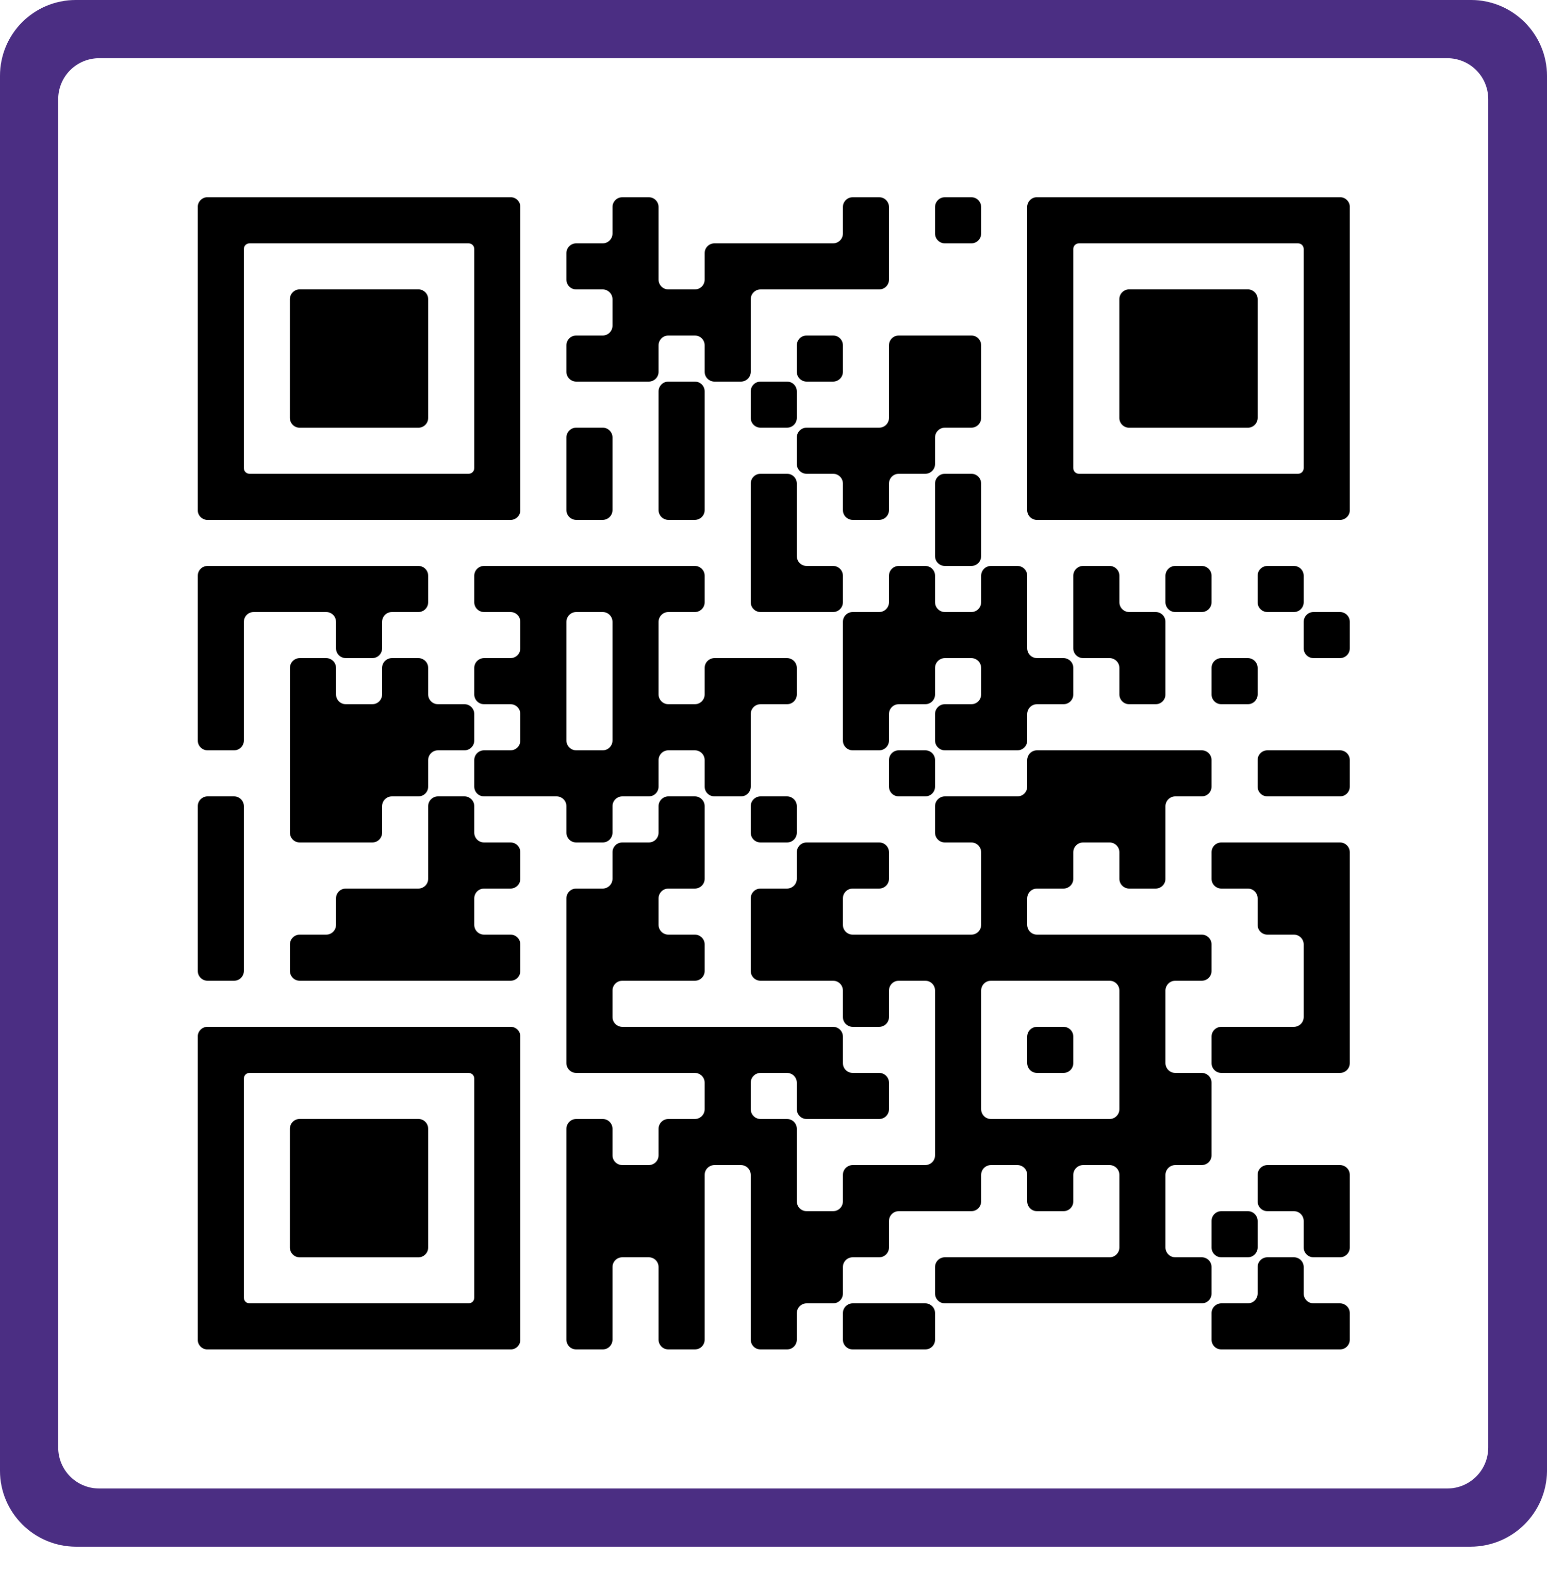
QR Codes
Copy and paste your QR code into your sign. Let Jamilah know if you need one made
These codes link to the contact information page of your website. If you don’t have a contact page, let Jamilah know where to link this to or add one to your website.
Architecture
Landscape Architecture
Real Estate

