Slide 1
Accessibility POP Session 3:
Simple Alternative Text
Spring POP sessions 2026
Mary-Colleen Jenkins |mcj6@uw.edu
Instruction Accessibility Specialist
UW-IT Accessible Technology Services (ATS)

Slide 2
Agenda for each Accessibility POP session
15-20 minutes: Learn or review one digital accessibility skill
20-30 minutes: Practice the skill or ask question
  Work on suggested activities
  Work on your own content
10 minutes: Check-in and set a personal mini-goal

Slide 3

What is Digital Accessibility?
Digital Accessibility means that we apply technical skills and tools to make all content we share online – websites, documents, slide decks, videos, etc., – fully accessible, equally available, and equally usable for ALL users, particularly people with disabilities who use assistive technology to navigate online content.
Within our capacity: There are tools and best practices we can learn to help us achieve foundational digital accessibility.
Beyond our capacity: There are resources at UW to help us with complex accessibility issues. More resources and tools are being developed and explored all the time.
Notes:
Why is digital accessibility important?
Our Students & Colleagues
Ensuring that students with disabilities have full access to our course materials
Ensuring that colleagues with disabilities can fully engage with our content
Building stronger, more inclusive digital content for all users
UW’s Mission
Preservation, advancement, and dissemination of knowledge
Serving the public good through education and discovery
Newly updated Americans with Disabilities Act (ADA) Rule
All public institutions and universities must make digital content, including academic course content, accessible by April 24, 2026.
We all create online content. When we learn basic skills to make our digital content accessible, we reduce barriers. Accessible content is essential for some; helpful for everyone:
Disabled students and colleagues
Neurodivergent students and colleagues
Readers who are experiencing stress or anxiety
Readers who are multitasking
Readers with low- or unstable internet access
English Language Learners

Slide 4
Audience, Purpose, Context (APC)
Keep APC in mind when selecting images and drafting alt text
Audience: Students in our courses
  Level of experience? Beginner, intermediate, advanced
  What are they coming in with and what are they leaving with?
Purpose: What is the learning objective?
  Why am I sharing this image?
  How does this image advance the learning objective?
Context: Where are we in the course right now?
  What have students been studying outside of class this week?
  Are images I'm sharing 100% new or are they somewhat familiar?

Slide 5
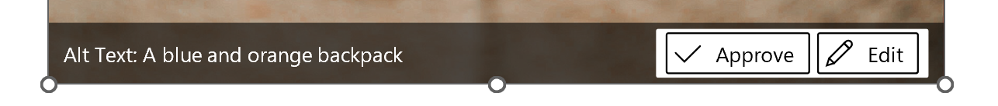
Best Practice: Add alt text to images
Alt text is an abbreviation for "Alternative Text"
Imagine talking to a person on the phone – how would you describe the image to a person who does not see it
Focus on key image details that point to meaning
Keep it clear and concise – takes some practice
Beware of AI-generated alt text; always edit it for nuance
Notes:
Purely decorative images can/should be hidden from screen readers
Do not include "image of" or "picture of"
Check your meaning: Describing colors may not be relevant
Three Types of images
Simple
Easily described in a short sentence that reflects context and meaning for readers who do not see it.
Decorative
Added for visual appeal; does not add meaning or context.
Complex
Contains substantial information that cannot be conveyed in a short alt text format.
Requires additional descriptive text.
Be intentional about images Audience, Purpose, Context (APC)
Audience:
Who is the target reader for this information? Who is benefitting from it?
Purpose:
What is the function of this image? What does this image offer to my audience’s understanding?
Context:
What elements of this image are most important for providing meaning and context to my audience?

Slide 6
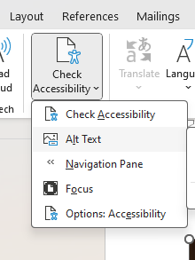
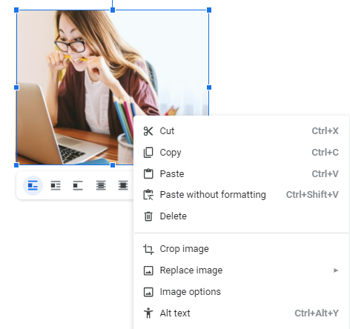
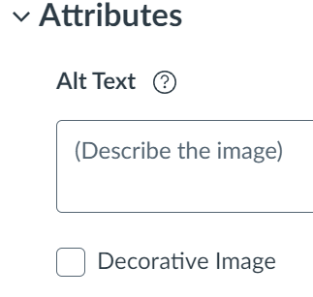
Essential Tool: Alt Text Field
All authoring tools have alt text; some open automatically
Microsoft Word
Google
Canvas

Slide 7
Group related images
Allows for one alt text ; leave alt text for individual images within the group blank
Microsoft Word
Google
Canvas
Notes:
To group: Cursor into text field with all images: Picture tab >> Arrange icon – Order, Group, Position. Choose "Group"

Slide 8
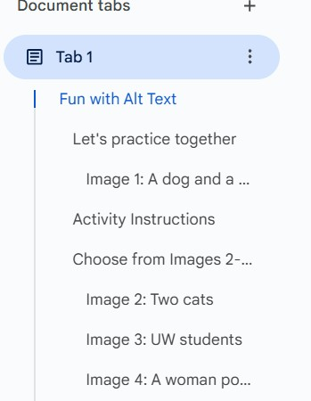
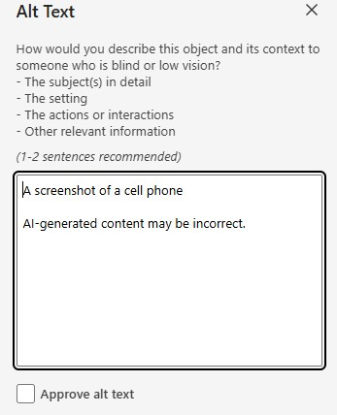


Caution: AI-generated Alternative Text
Always review AI-generated alt text and edit it for accuracy and nuance.

Slide 9
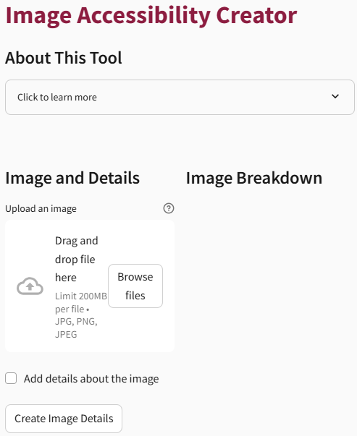
New Tool for drafting Alt Text
ASU Image Accessibility Creator
This tool has a lot of potential, but it’s important to learn the basics of creating alt text yourself before relying on a tool.
Upload an image
Add relevant details that point to context & meaning
Select “Create Image Details”
Carefully review and edit
Notes:
This tool has a lot of potential, but it’s super important to understand alt text conventions and uses on your own before relying on a tool. Good to build skills first, then use the tool.

Slide 10
Activity: Try 1 of 3 Easy Tasks
Open an existing document or slide deck that includes images and do a short assessment
    Note which images are required to establish context for your audience.
    Note which images are supplemental – nice, but not necessary?
    Note which images are purely decorative.
Open an existing document or slide deck in your favorite platform that includes images and manually check the alt text field
    Has AI-generated alt text been added? Is it correct?
    If the field is empty, practice adding alt text
Open and Explore the Arizona State University Image Description Generator
  https://teachonline.asu.edu/image-accessibility-generator/
Notes:
https://teachonline.asu.edu/image-accessibility-generator/

Slide 11
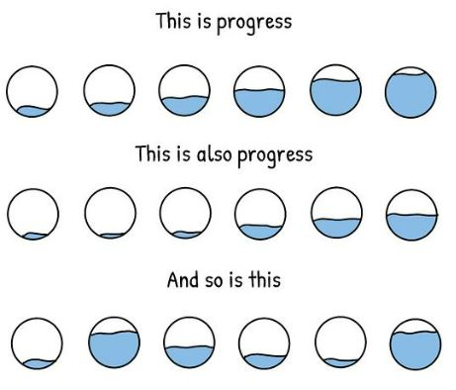
April 29: Accessible Slide Design
Three ways to take your next steps: toward progress over perfection:
Reflect: How can I apply this skill to my next slide deck or document?
Start a Digital Accessibility "I Did" list
    Faculty “I Did” List Template
  Staff “I Did” List Template
Invite a friend to join you in the next POP session!
Notes:
Graphic credit to Mounika.studio
Full description of Progress graphic by mounika.studio. The graphic shows three rows of text alternating with three rows of hand-drawn circles. There are six circles in each row, divided at different parts of the circle with a wavy black line. Above the line, the circle is white. Below the line, the circle is blue. Each circle has a different level of blue – indicating fullness. Some have low levels of blue, some have high levels of blue, and in between. The first line of text says: This is progress. The second line of text says: This is also progress. The third line of text says: And so is this. In short, all levels mean progress.

Slide 12
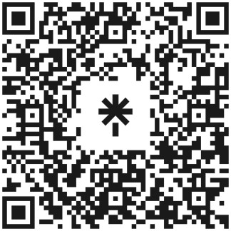
Questions?
Contact me! mcj6@uw.edu
Check out my Resource Linktree
Get help from Accessible Technology Services
https://www.washington.edu/accesstech/help/
UW
https://linktr.ee/a11ylinksuw
Notes:
https://linktr.ee/a11ylinksuw
mcj6@uw.edu

