Slide 1
Accessibility POP Session 1: Structured Headings Spring 2026 Progress Over Perfection (POP) series
Mary-Colleen Jenkins |mcj6@uw.edu
Instruction Accessibility Specialist
UW-IT Accessible Technology Services (ATS)

Slide 2
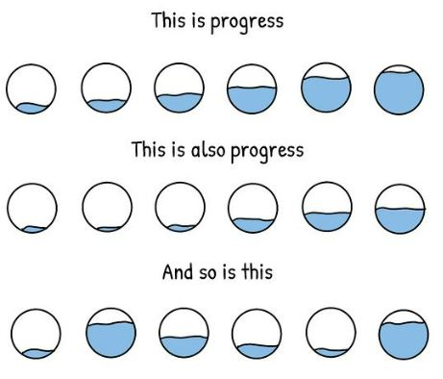
Agenda For Accessibility POP Sessions
15-20 minutes: Learn or review one digital accessibility skill
30-35 minutes: Practice the skill or ask question
Work on suggested activities
Work on your own content
Remaining time : Check-in and set a personal mini-goal

Slide 3

What is Digital Accessibility?
Digital Accessibility means that we apply technical skills and tools to make all content we share online – websites, documents, slide decks, videos, etc., – fully accessible, equally available, and equally usable for ALL users, particularly people with disabilities who use assistive technology to navigate online content.
Within our capacity: There are tools and best practices we can learn to help us achieve foundational digital accessibility.
Beyond our capacity: There are resources at UW to help us with complex accessibility issues. More resources and tools are being developed and explored all the time.
Notes:
Why is digital accessibility important?
Our Students & Colleagues
Ensuring that students with disabilities have full access to our course materials
Ensuring that colleagues with disabilities can fully engage with our content
Building stronger, more inclusive digital content for all users
UW’s Mission
Preservation, advancement, and dissemination of knowledge
Serving the public good through education and discovery
Newly updated Americans with Disabilities Act (ADA) Rule
All public institutions and universities must make digital content, including academic course content, accessible by April 24, 2026.
We all create online content. When we learn basic skills to make our digital content accessible, we reduce barriers. Accessible content is essential for some; helpful for everyone:
Disabled students and colleagues
Neurodivergent students and colleagues
Readers who are experiencing stress or anxiety
Readers who are multitasking
Readers with low- or unstable internet access
English Language Learners

Slide 4
Best Practice: Use Structured Headings
Structured headings are announced by screen reader technology so users can understand the document's structure and choose how to navigate content. They also help us create a navigation structure in our documents.
We use structured headings because assistive technology cannot recognize headings created manually through font styling alone:
X Increasing font size
X Bolding text
X Underlining text
X Italicizing text
Notes:
Authoring tools like Word, Google, Substack, etc. have style tools in the tool bar
Assistive technology cannot recognize unstructured headings
Created by manually increasing font size
Created by manually bolding, underlining, or italicizing text
Other benefits for structured headings = ability to auto generate Tables of Contents, easier skimming and scanning by busy readers, creates navigation for audio files of text, improved formatting

Slide 5
Syllabus: No Structured Headings
Introduction to Physics Course Syllabus Textbook Our sole text for this course will be Introduction to Physics, Second Edition, authored by the instructor. Course Objectives to offer students exposure to basic principles of Physics to provide students with rich, thought-provoking discussions during lecture sessions to provide students with experiential learning opportunities during laboratory sessions. Class Schedule Week Topic Reading Assignment 1 Course Introduction Chapter 1 2 Inertia, equilibrium, kinematics Chapters 2-3 3 Newton’s laws, vectors, momentum, energy Chapters 4-7 4 Matter, elasticity, scaling Chapters 8-10 5 Wave kinematics, sound, electricity, magnetism, induction Chapter 11-15 6 Light, reflection and refraction, emission Chapters 15-18 7 Review, final exam Grades Grades will be assigned on a ten point scale (90 to 100 is an A, 80 to 89 is a B, etc.). Homework, exams, and projects will be weighted as follows: Homework Exams Projects 1 2 Final 1 2 Final 15% 15% 15% 20% 10% 10% 15%

Slide 6
Who benefits from structured headings?
Blind or low-vision readers
Readers who have print disabilities (e.g., dyslexia)
Readers with cognitive impairments that make decoding or processing written text difficult
Readers who experience migraines, concussions, or other health conditions
Readers who skim and scan text
Readers who prefer to listen to content
Readers who like to navigate with built-in Tables of Content
Readers who primarily use a keyboard instead of a mouse

Slide 7

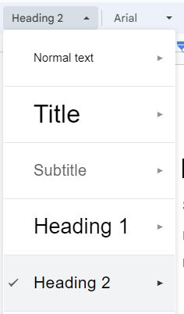
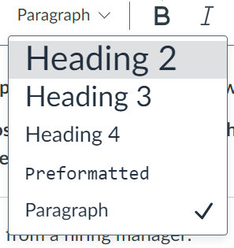


Essential Tool: Heading Styles Tool
Microsoft Word
Google
Canvas
Notes:
Use Heading Level 1 for titles (and only once)
Heading Level 2 is for main sections
Heading Level 3 (and above) is for tertiary subheads
Avoid skipping levels – e.g., going from Heading 1 to 3.
Canvas starts with Heading 2 because the Title text box is basically Heading 1
'preformatted text' is and here's what she said:
Preformatted text is a block of text where whitespace, line breaks, and spacing are preserved exactly as they appear in the source code, unlike standard text which is automatically adjusted by the display software. This format is essential for displaying content like programming code, poetry, and song lyrics where the precise layout is meaningful and needs to remain intact. In web development, the HTML <pre> tag is used to create preformatted text blocks.

Slide 8
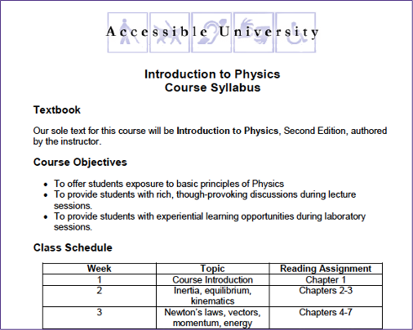
Same Syllabus: Structured Headings

Slide 9
Activity: Try 1 of 3 Easy Tasks
Open a blank document in your favorite platform and find Heading Styles in the toolbar. Experiment with different heading styles, try changing appearance, see what it’s all about.
Open an existing document in your favorite authoring platform and check your headings. Practice adding structured headings if you haven’t done so.
Put your cursor into any part of your heading. Right click to see the heading level.
If it is labeled “normal” or “paragraph,” then it is not a structured heading
Open a document or Canvas page and listen to how the page is read aloud by using tools available: Immersive Reader, VoiceOver, or the audio option in Canvas alternative formats. Does it announce heading levels?

Slide 10
April 8: Accessibility Checkers
Three ways to take your next steps: toward progress over perfection:
Reflect: How can I apply this skill to my next document or Canvas page?
Start a Digital Accessibility "I Did" list
Faculty “I Did” List Template
Staff “I Did” List Template
Invite a friend to join you in the next POP session!
Notes:
Graphic credit to Mounika.studio
Full description of Progress graphic by mounika.studio. The graphic shows three rows of text alternating with three rows of hand-drawn circles. There are six circles in each row, divided at different parts of the circle with a wavy black line. Above the line, the circle is white. Below the line, the circle is blue. Each circle has a different level of blue – indicating fullness. Some have low levels of blue, some have high levels of blue, and in between. The first line of text says: This is progress. The second line of text says: This is also progress. The third line of text says: And so is this. In short, all levels mean progress.

Slide 11
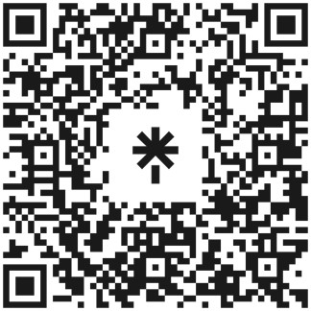
Questions?
Contact me! mcj6@uw.edu
Check out the Accessibility Resource Linktree
Get help from Accessible Technology Services
Subscribe to the Digital Accessibility Calendar to keep up with upcoming training and events at UW.
UW
https://linktr.ee/a11ylinksuw
Notes:
https://linktr.ee/a11ylinksuw
mcj6@uw.edu

