Slide 1
Accessibility POP Session 2: Accessibility Checkers 101 Spring 2026 Progress Over Perfection (POP) series
Mary-Colleen Jenkins |mcj6@uw.edu
Instruction Accessibility Specialist
UW-IT Accessible Technology Services (ATS)

Slide 2

Agenda For Accessibility POP Sessions
15-20 minutes: Learn or review one digital accessibility skill
30-35 minutes: Practice the skill or ask question
Work on suggested activities
Work on your own content
Remaining time : Check-in and set a personal mini-goal

Slide 3

What is Digital Accessibility?
Digital Accessibility means that we apply technical skills and tools to make all content we share online – websites, documents, slide decks, videos, etc., – fully accessible, equally available, and equally usable for ALL users, particularly people with disabilities who use assistive technology to navigate online content.
Within our capacity: There are tools and best practices we can learn to help us achieve foundational digital accessibility.
Beyond our capacity: There are resources at UW to help us with complex accessibility issues. More resources and tools are being developed and explored all the time.
Notes:
Why is digital accessibility important?
Our Students & Colleagues
Ensuring that students with disabilities have full access to our course materials
Ensuring that colleagues with disabilities can fully engage with our content
Building stronger, more inclusive digital content for all users
UW’s Mission
Preservation, advancement, and dissemination of knowledge
Serving the public good through education and discovery
Newly updated Americans with Disabilities Act (ADA) Rule
All public institutions and universities must make digital content, including academic course content, accessible by April 24, 2026.
We all create online content. When we learn basic skills to make our digital content accessible, we reduce barriers. Accessible content is essential for some; helpful for everyone:
Disabled students and colleagues
Neurodivergent students and colleagues
Readers who are experiencing stress or anxiety
Readers who are multitasking
Readers with low- or unstable internet access
English Language Learners

Slide 4
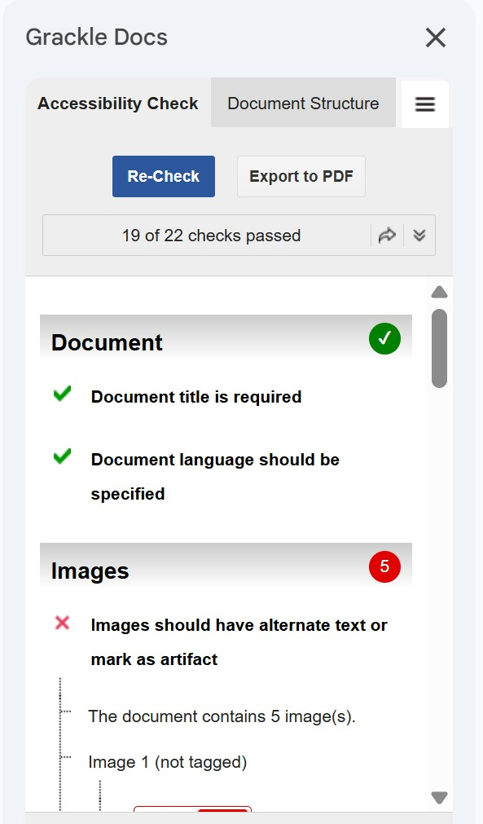
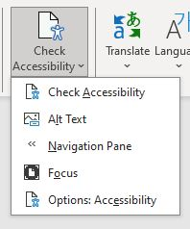
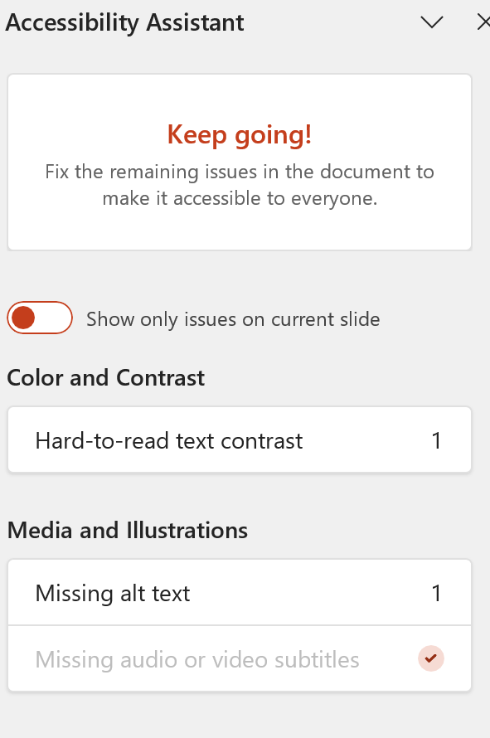
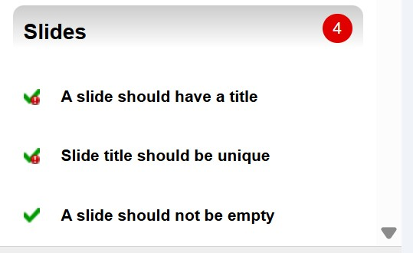

Best Practice: Use Accessibility Checkers
Grackle Accessibility Checkers are now available for Google Docs, slides, and sheets.
Microsoft products have robust and interactive Accessibility Checkers.

Slide 5
Accessibility Checkers are the fastest way to learn
Checks and offer guidance on fixing the most common accessibility errors in content
Helps you become familiar with digital accessibility terms and concepts
Helps jump-start new digital accessibility habits
Helps identify within your capacity issues
Helps identify beyond your capacity issues
Gives you the vocabulary for asking questions when you seek help

Slide 6
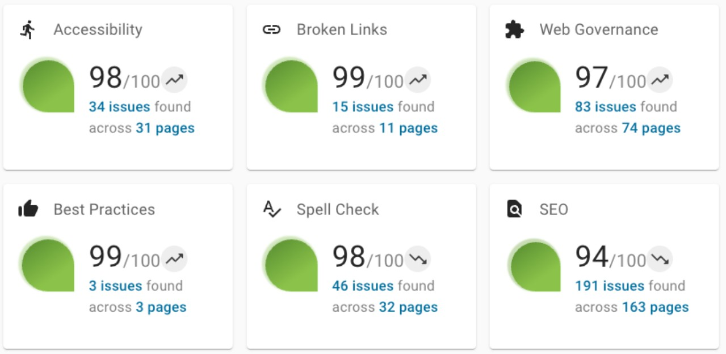
DubBot Web Accessibility Checker
UW-wide tool, you can submit your website
100+ accessibility checks with reports
Does not make fixes for you
Manual review is still a best practice

Slide 7
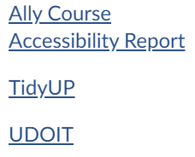
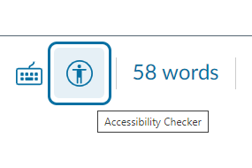
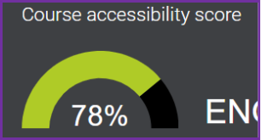

Canvas accessibility checkers
Canvas has two levels of built-in of accessibility checkers:
Accessibility Checker for Individual Pages
Ally Course Accessibility Report for the entire Canvas Course
Plus, the UDOIT Accessibility Checker

Slide 8
Two Canvas accessibility checkers?
Built-in Canvas Checkers
Familiar look, easy to absorb
Quick in-the-moment snapshots with dial icons in individual pages/files
Easy to check as you're creating content in pages, etc.
Canvas Accessibility score = UW's target goals for making progress
Doesn't check headings
UDOIT
More features = takes a little time to explore
Various ways to filter through content to set priorities
Efficiency: Accessibility fixes can be applied across multiple pages from one place
Options for PDF conversion to HTML, Canvas Pages, some auto tagging

Slide 9
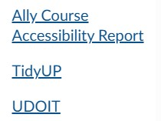
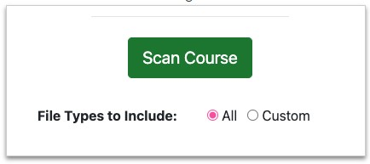
Is TidyUP an accessibility checker?
No, but TidyUP helps you easily clean up outdated Canvas files and pages to "declutter" courses.
Run TidyUP at the start of the quarter
Run TidyUP at the end of the quarter
Bonus: TidyUP is also a helpful way to see an overview of your course content and how you use it.

Slide 10
Activity: Try 1 of 5 Easy Tasks
Open a Microsoft document or PowerPoint slide deck and run the accessibility checker.
What can you observe from the flagged items? Are there adjustments you can make when you create your next document or slide deck to reduce the number of items flagged?
Open a Canvas and run the accessibility checker for an individual page
Select “Edit” to open the text box (aka Rich Content Editor)
Open the UDOIT in Canvas and explore various ways to filter and check files and folders.
Are you a Google user and didn't know about Grackle?
Read about it: Grackle at UW
Install the Grackle extensions you want: Grackle Docs, Grackle Sheets, Grackle Slides
Are you a website owner and want to get your site into DubBot?
Read about it: DubBot Web Accessibility Checker and submit

Slide 11
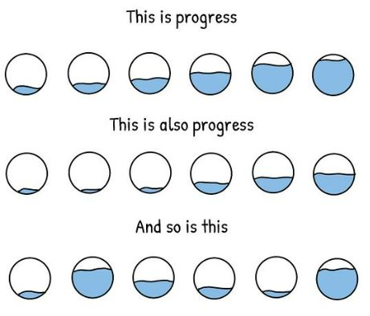
April 22: Simple Alternative Text
Four ways to take your next steps: toward progress over perfection:
Reflect: How can I apply this skill to my next document or Canvas page?
Start a Digital Accessibility "I Did" list
Faculty “I Did” List Template
Staff “I Did” List Template
Invite a friend to join you in the next POP session!
Register for UW's Global Accessibility Awareness Day on May 21!
Notes:
Graphic credit to Mounika.studio
Full description of Progress graphic by mounika.studio. The graphic shows three rows of text alternating with three rows of hand-drawn circles. There are six circles in each row, divided at different parts of the circle with a wavy black line. Above the line, the circle is white. Below the line, the circle is blue. Each circle has a different level of blue – indicating fullness. Some have low levels of blue, some have high levels of blue, and in between. The first line of text says: This is progress. The second line of text says: This is also progress. The third line of text says: And so is this. In short, all levels mean progress.

Slide 12
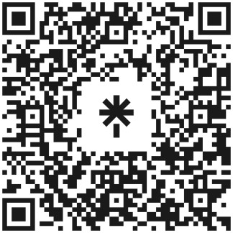
Questions?
Contact me! mcj6@uw.edu
Check out the Accessibility Resource Linktree
Get help from Accessible Technology Services
Subscribe to the Digital Accessibility Calendar to keep up with upcoming training and events at UW.
UW
https://linktr.ee/a11ylinksuw
Notes:
https://linktr.ee/a11ylinksuw
mcj6@uw.edu

