Slide 1

RESERVED FOR
EASY ACCESS GUESTS

Slide 2
CBE GRADUATION CELEBRATION
INFO
TABLE
PROGRAMS
LOST &
FOUND

Slide 3
CBE GRADUATION CELEBRATION
TICKET
WILL
CALL
GRADUATE LAST NAME
A - M

Slide 4
CBE GRADUATION CELEBRATION
TICKET
WILL CALL

Slide 5
CBE GRADUATION CELEBRATION
TICKET
WILL
CALL
GRADUATE LAST NAME
N - Z

Slide 6
RESERVED FOR
EASY ACCESS GUESTS

Slide 7

Please remain silent during the celebration.
Thank you!

Slide 8

Please remain silent during the celebration.
Thank you!

Slide 9

PLEASE FIND A SEAT
The ceremony will begin shortly

Slide 10
PLEASE FIND A SEAT
The ceremony will begin shortly

Slide 11
PLEASE FIND A SEAT
The ceremony will begin shortly

Slide 12

GRADUATES
ONLY
BEYOND THIS POINT

Slide 13
GRADUATES
ONLY
OVERFLOW OPEN @2:30

Slide 14


GRADUATES
ONLY
BEYOND THIS POINT

Slide 15
GRADUATE SEATING
AVAILABLE AHEAD

Slide 16

GRADUATE SEATING
AVAILABLE AHEAD

Slide 17
GRADUATE SEATING

Slide 18
GRADUATE SEATING

Slide 19
X 2
ACCESSIBILITY
SEATING
Maximum Capacity:
2 guests

Slide 20

X 2
ACCESSIBILITY
SEATING
Maximum Capacity:
2 guests

Slide 21

X 2
WHEELCHAIR
SEATING
Maximum Capacity:
2 guests

Slide 22

X 2
WHEELCHAIR
SEATING
Maximum Capacity:
2 guests

Slide 23

MEN’S
RESTROOM

Slide 24
MEN’S
RESTROOM

Slide 25
MEN’S
RESTROOM

Slide 26
MEN’S
RESTROOM

Slide 27
MEN’S
RESTROOM
Additional restrooms are available on other floors

Slide 28
MEN’S
RESTROOM
Additional restrooms are available on other floors

Slide 29
MEN’S
RESTROOM
Additional restrooms are available on other floors

Slide 30

WOMEN’S
RESTROOM

Slide 31
WOMEN’S
RESTROOM

Slide 32
WOMEN’S
RESTROOM

Slide 33
WOMEN’S
RESTROOM

Slide 34
WOMEN’S
RESTROOM
Additional restrooms are available on other floors

Slide 35
WOMEN’S
RESTROOM
Additional restrooms are available on other floors

Slide 36
WOMEN’S
RESTROOM
Additional restrooms are available on other floors

Slide 37

ACCESSIBLE
RESTROOMS

Slide 38
ACCESSIBLE
RESTROOMS

Slide 39
ACCESSIBLE
RESTROOMS

Slide 40
ACCESSIBLE
RESTROOMS

Slide 41
TASSEL PROTOCOL
Undergraduate:
Right, then move left cross stage
Graduate:
Stay left

Slide 42
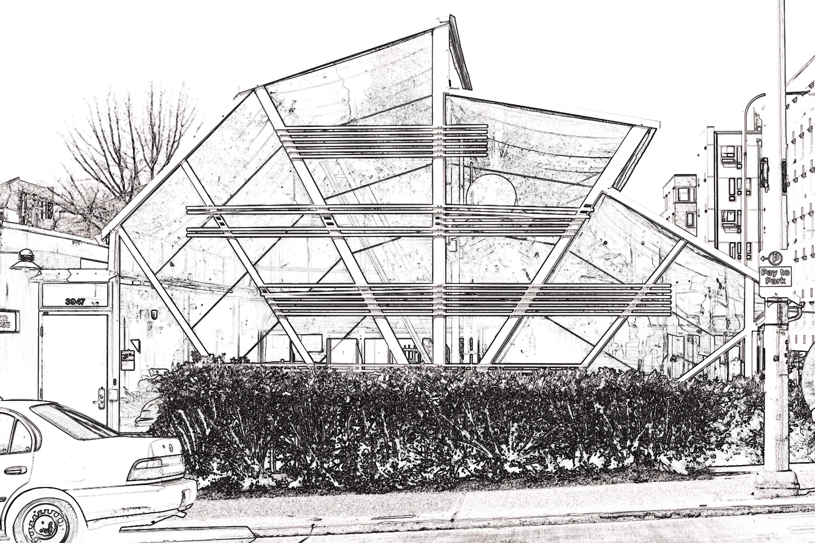
2026
Graduation
Celebration
COLLEGE OF BUILT ENVIRONMENTS
Overflow
Livestream available in the Community Design Building

Slide 43
2026
Graduation
Celebration
COLLEGE OF BUILT ENVIRONMENTS
Overflow
Livestream available in the Community Design Building

Slide 44
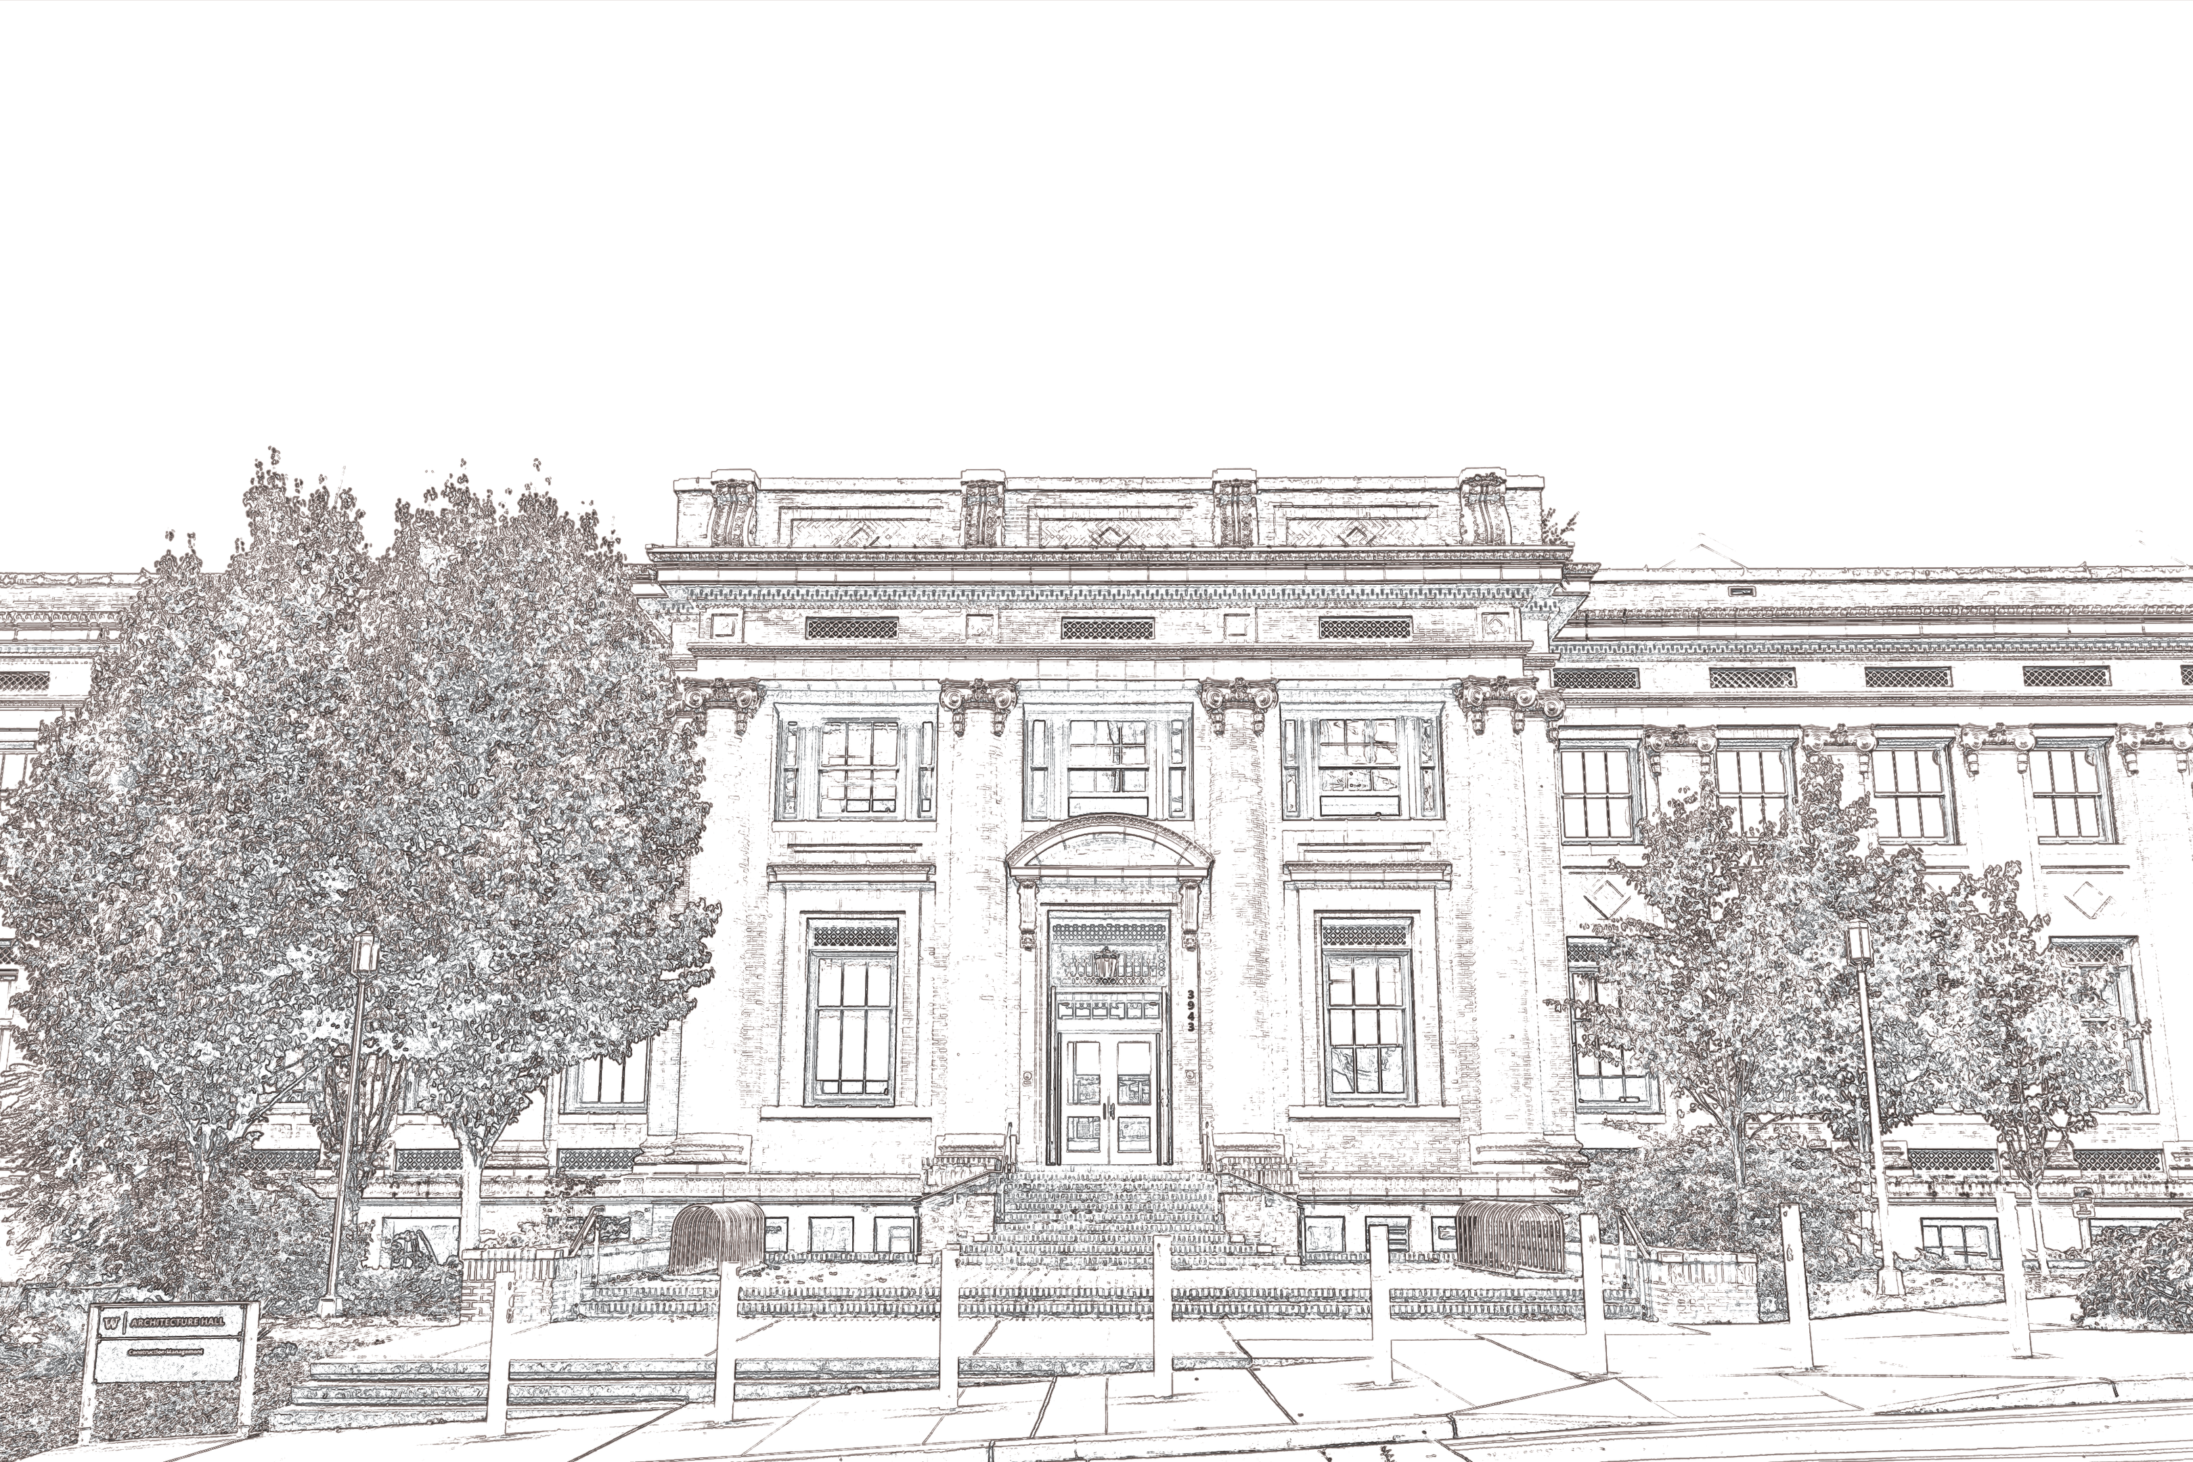
2026
Graduation
Celebration
COLLEGE OF BUILT ENVIRONMENTS
Livestream available in
ARCH G042
Overflow

Slide 45
2026
Graduation
Celebration
COLLEGE OF BUILT ENVIRONMENTS
Livestream available in
ARCH 160
Overflow

Slide 46
2026
Graduation
Celebration
COLLEGE OF BUILT ENVIRONMENTS
Livestream available in
ARCH G070
Overflow

Slide 47
2026
Graduation
Celebration
COLLEGE OF BUILT ENVIRONMENTS
Livestream available in
ARCH 160
Overflow

Slide 48
2026
Graduation
Celebration
COLLEGE OF BUILT ENVIRONMENTS
Livestream available in
ARCH G042
Overflow

Slide 49
2026
Graduation
Celebration
COLLEGE OF BUILT ENVIRONMENTS
Livestream available in
ARCH G070
Overflow

Slide 50

Elevator

Slide 51
Elevator

Slide 52
EVENT IN PROGRESS

Slide 53
EVENT IN PROGRESS

Slide 54
EVENT IN PROGRESS

Slide 55
PLEASE DO NOT ENTER HERE
USE NORTH EAST ENTRY

